Slide 1

Secure Website with Role-Based Access and JWT Authentication
Submitted To:
Prof. Nital Shah
Instructor (Information Encoding Standards)

Slide 2
Overview
Secure Website with Role-Based Access and JWT Authentication
Our project focuses on developing a secure website that incorporates role-based access control, robust authentication, and authorization mechanisms. Following are the key features:
Role Assignment at Registration
User Roles: During the registration process, users are assigned specific roles (e.g., Admin, Editor, Viewer) based on their intended level of access and responsibilities. Administrators have the ability to manage and update user roles as needed, ensuring that access permissions are always up-to-date.
Authentication and Authorization
Authentication: The website employs a secure authentication process to verify user identities. Users must provide valid credentials (e.g., username and password) to gain access.
Authorization: Once authenticated, users are granted access to resources based on their assigned roles. This ensures that users can only access the features and data they are authorized to use.

Slide 3
Data Validation
Input Validation: The website includes comprehensive validation mechanisms to ensure that all user inputs are accurate and secure.
Form Validation: All forms on the website are validated to ensure that the data entered by users meets the required criteria before being processed.
JWT Token Integration
JWT Authentication: The website uses JSON Web Tokens (JWT) for secure authentication. Upon successful login, a JWT token is generated and issued to the user.
Token-Based Access: The JWT token is used to authenticate subsequent requests, ensuring that only authorized users can access protected resources. The token contains encoded information about the user’s identity and roles, which is verified on each request.
By implementing these features, our project aims to provide a secure and user-friendly website that ensures proper access control, data integrity, and a seamless user experience.

Slide 4
About Group Members
Chandresh Atulbhai Patel (200595392)
Committed to aligning encoding practices with privacy and security regulations while optimizing data usage.
Ajju Dangol (200576149)
Passionate about ensuring accurate and secure data communication.
Nancy Jangwal (200591978)
Aims to leverage standards to improve data storage, retrieval, and overall data management processes.
Brittney Nitin Gohil (200595828)
Dedicated to exploring how encoding techniques can enhance data security and integrity in large-scale data environments.

Slide 5
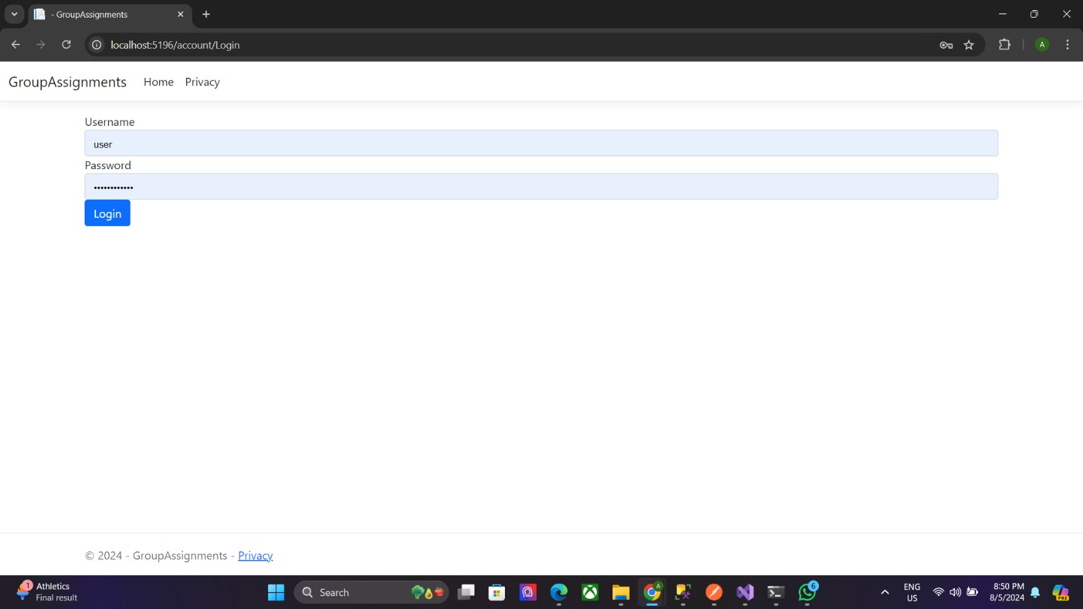
Demonstration

Slide 6


Slide 7
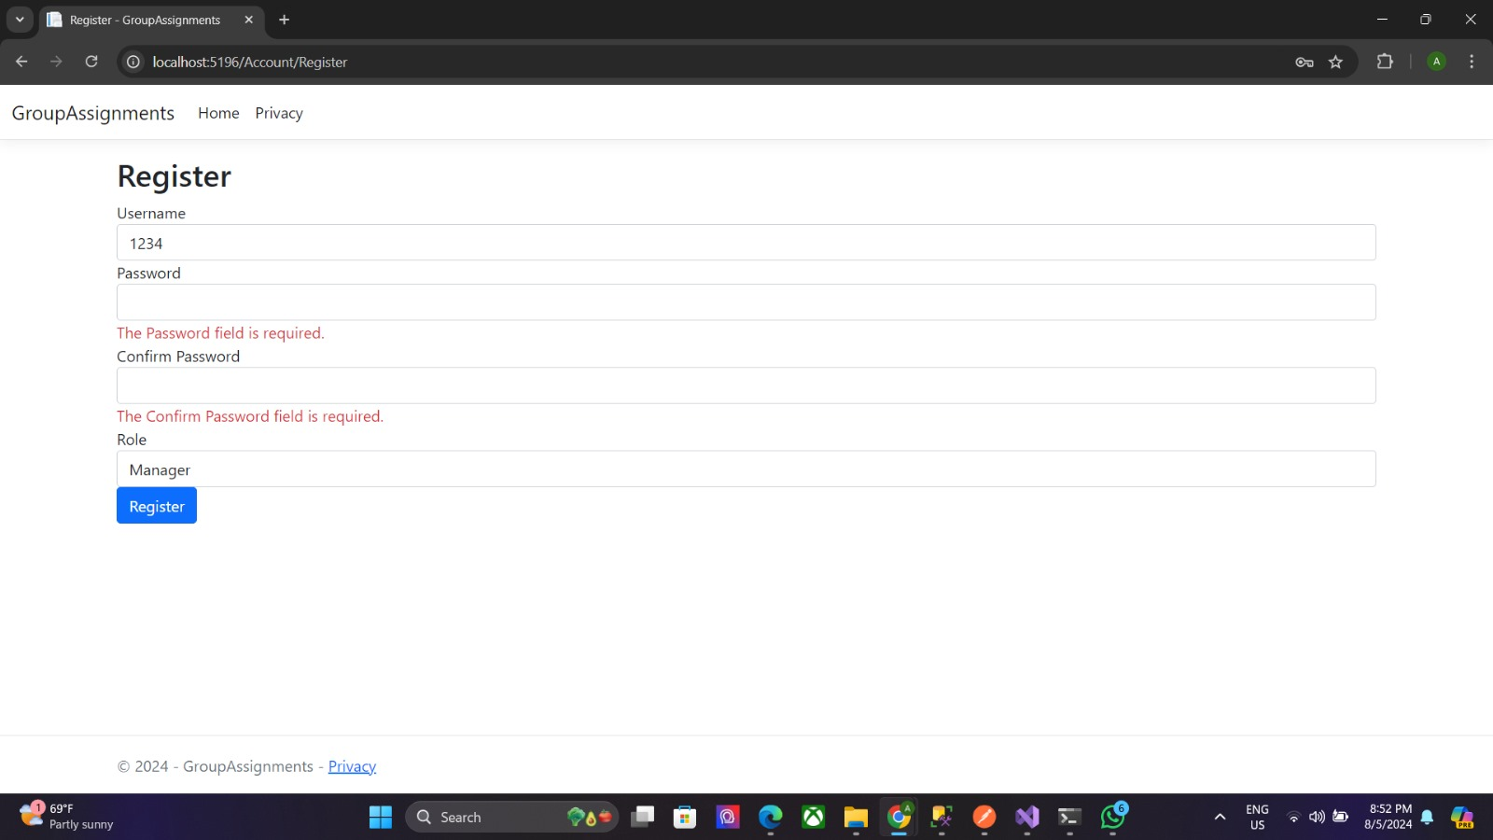

Slide 8
